Slide 1
Aaron‘s storyline

Slide 2
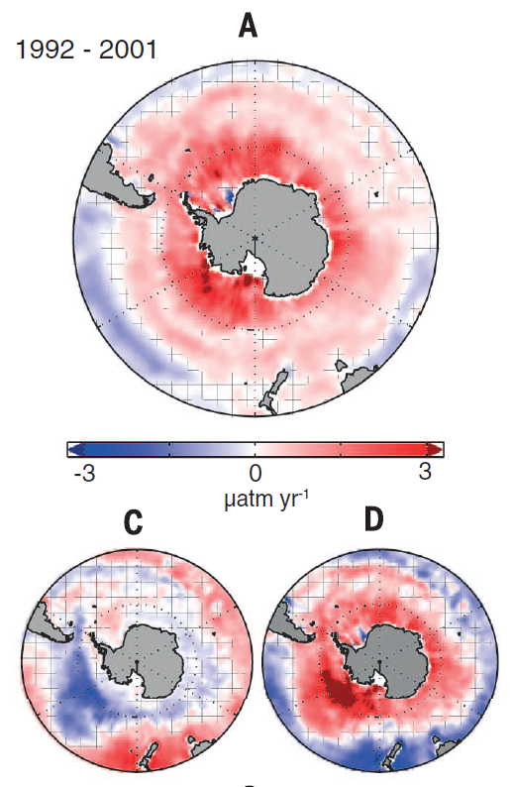
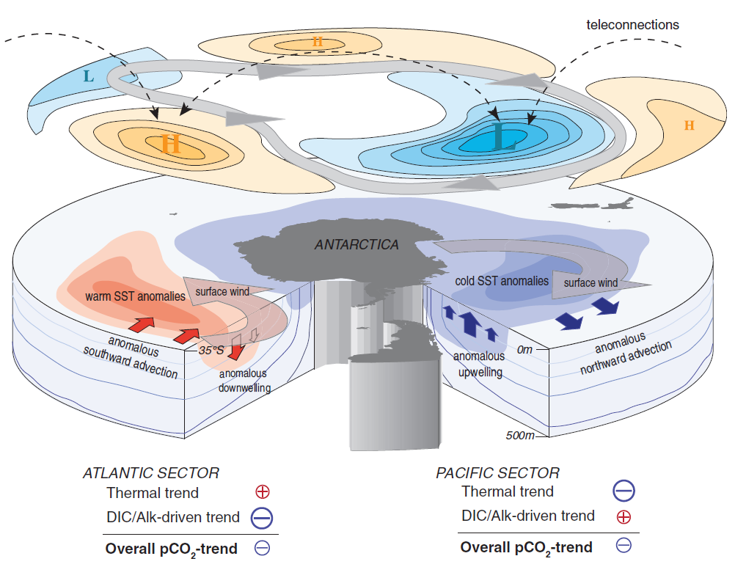

Observations (Landschützer et al. 2015) show anomalous outgassing in the 1990s.

Slide 3
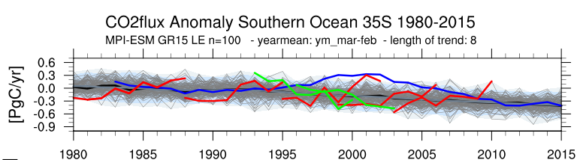
I identify similar decadal trends in the MPI-ESM LE.

Slide 4
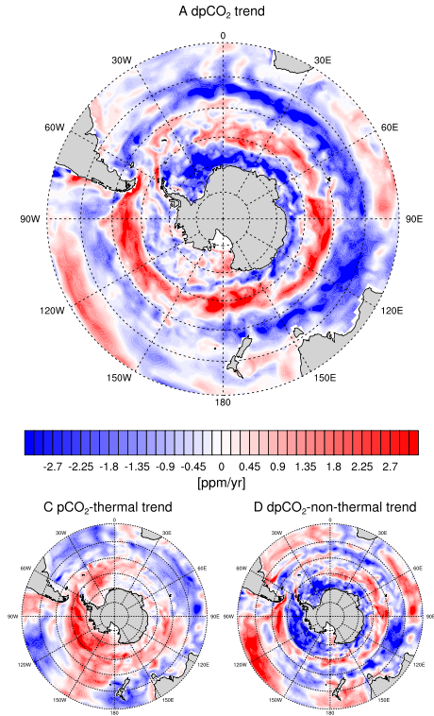
The pCO2 trends are dominated by non-thermal processes. It‘s not a direct T effect.

Slide 5
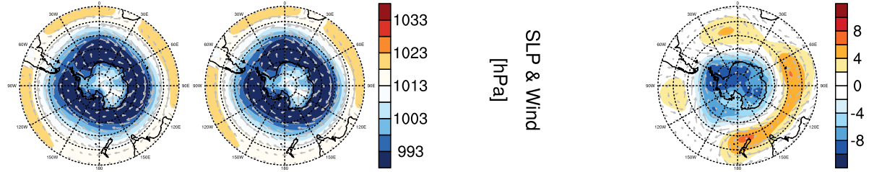
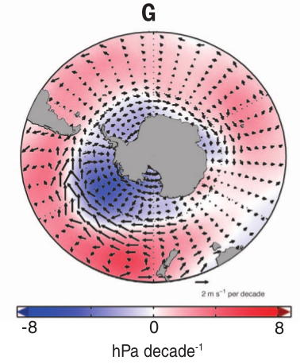
SLP & patterns lead to increased upwelling as one explanation.
trend

Slide 6
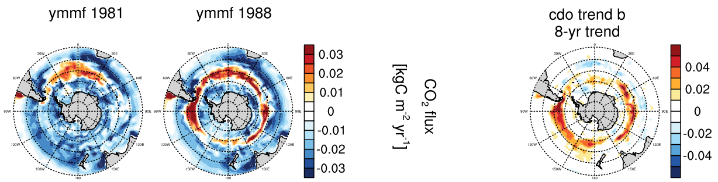
Second explanation: In the ensemble runs, the anomalous outgassing trend is most dominant in S50s, ...

Slide 7
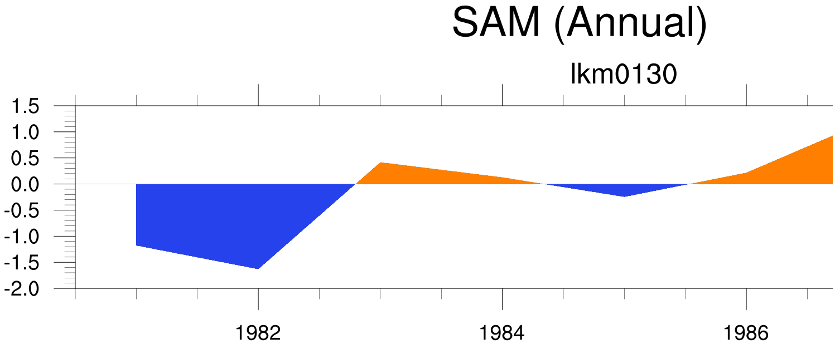
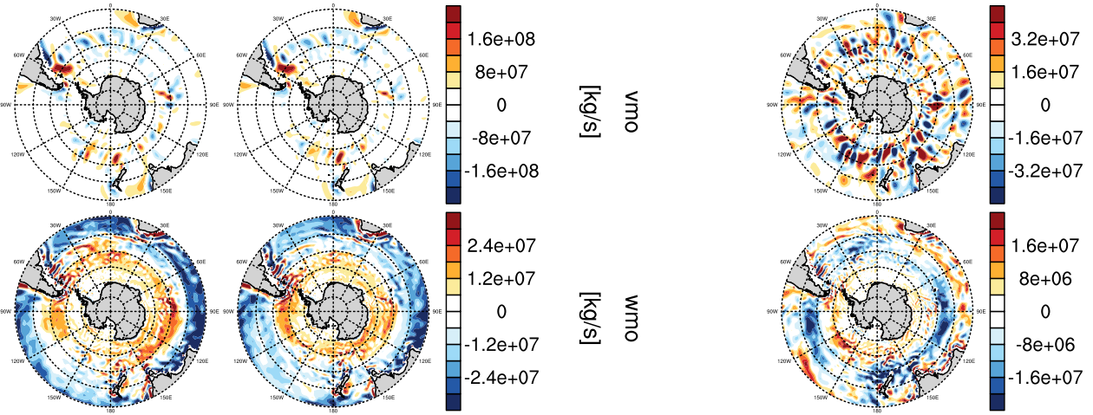
...a region with increased upwelling is induced by intensifying winds.

Slide 8
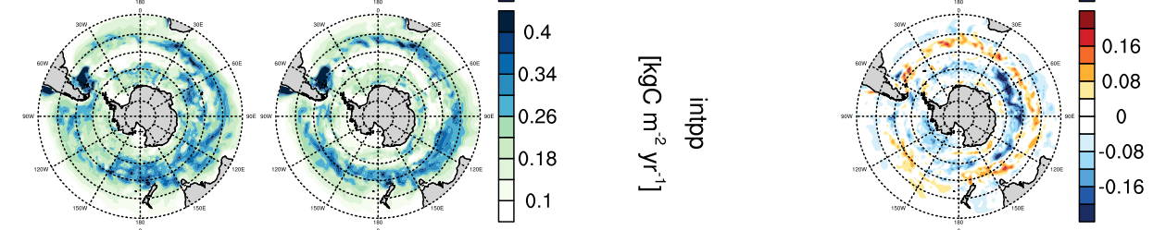
But also primary production follows this trend.

Slide 9
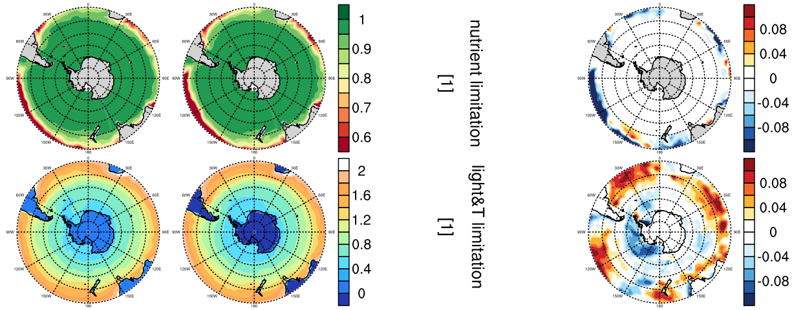
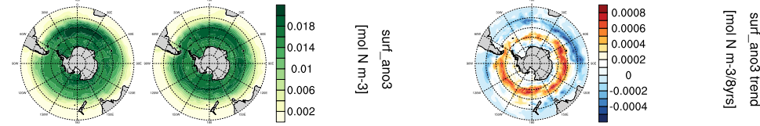
Primary production in the Southern Ocean in HAMOCC is not limited by nutrients, ...
Nutrients increase where less INTPP

Slide 10
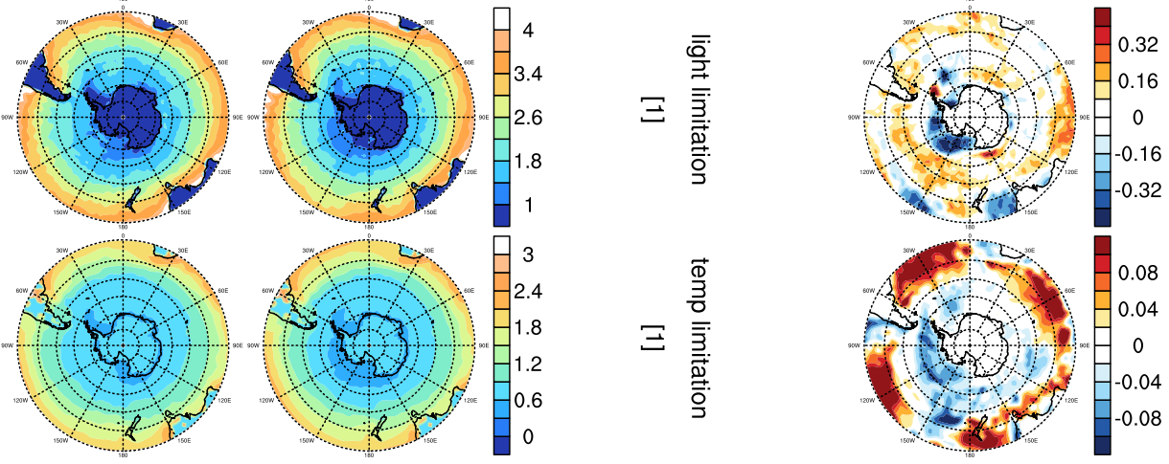
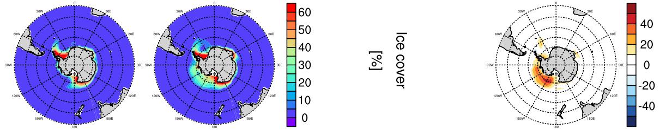
… but by light and temperature.
Ice formed in Ross Sea

Slide 11
Primary production … decreases S30s because of nutrients … increases S40s because of temperature effect … decreases S50s temperature effect

Slide 12
Conclusion
Anomalous outgassing trends in the Southern Ocean Carbon Sink can be explained by non-thermal direct effects on pco2: Increased upwelling and thermal-enhanced primary production

Slide 13
Backup slides raw

Slide 14
Aaron’s vs Landschutzer 2015

Slide 16
Landschützer et al. 2015

Slide 18
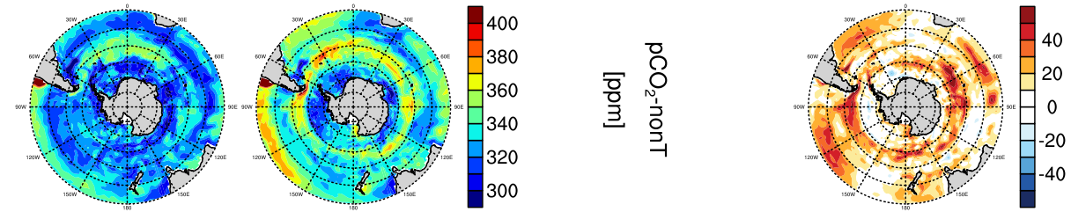
thermal separation nach Jassby and Platt (1976)

Slide 19
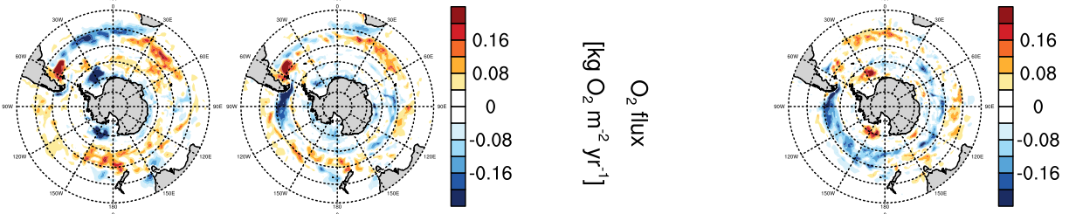

Slide 20
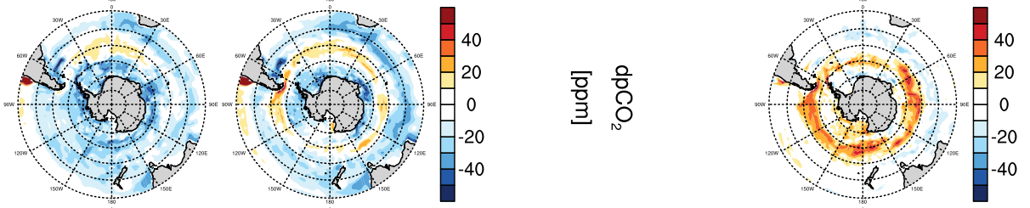
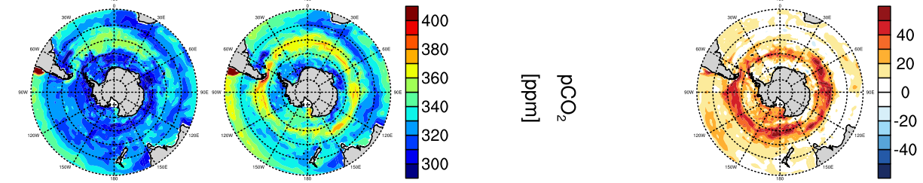

Slide 22
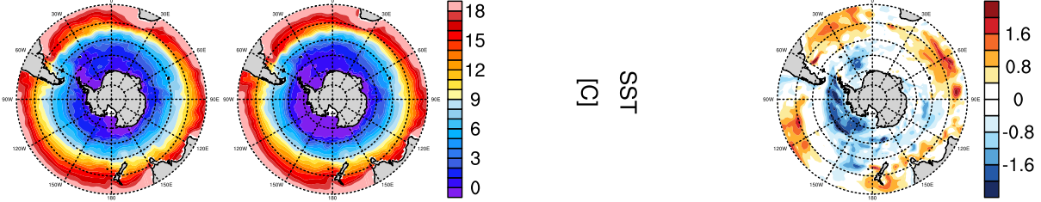

Slide 25
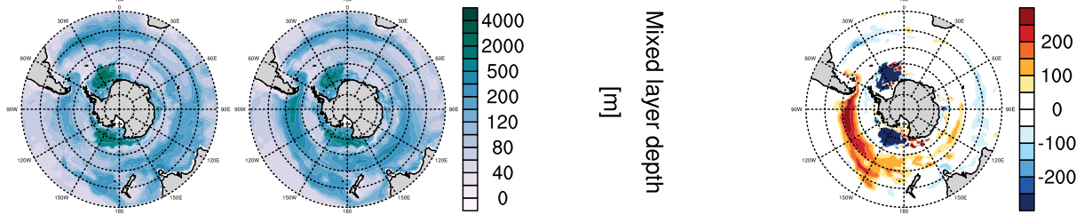

Slide 26


